Slide 1
Heaps
Dr. Maher Mneimneh

Slide 2
The ADT Heap: Applications
Heap operations: add element, get minimum, remove minimum
Option 1: use sorted array
Insert new element in its position: O(n)
Get the maximum/remove maximum : O(1)
Option 2: use unsorted array
Insert new element at end: O(1)
Get maximum/remove maximum: O(n)
Option 3: use heap
Insert each new element: O(logn)
Get the maximum: O(1)
Remove maximum: O(logn)
3rd option is better
Applications:
Priority queue
Heapsort
Graph algorithms such as finding shortest paths

Slide 3
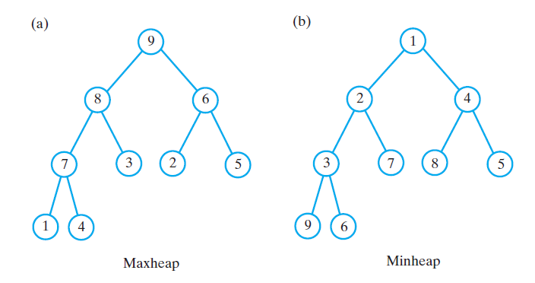
The ADT Heap
A heap:
Complete binary tree
Nodes contain Comparable objects
Organization
Each node contains object no smaller (or no larger) than objects in descendants
Maxheap, object in each node greater than or equal to descendant
Minheap, object in each node less than or equal to descendant

Slide 4
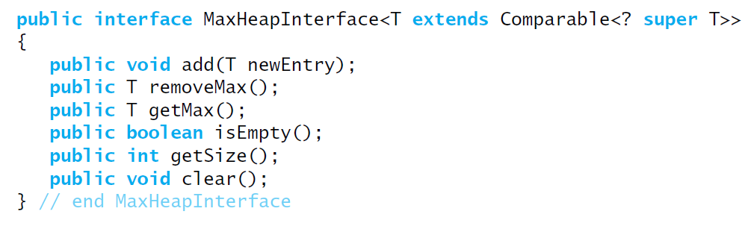
The ADT Heap
Interface

Slide 5
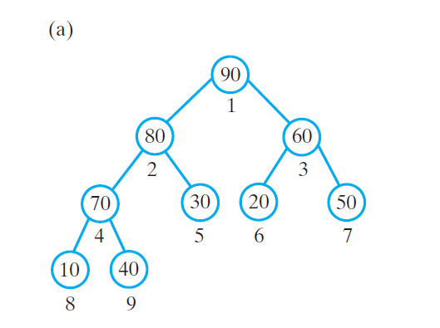
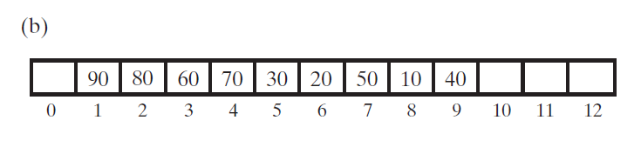
Array to Represent a Heap
Begin by using array to represent complete binary tree.
Complete tree is :
full to its next-to-last level
leaves on last level are filled from left to right
Number the tree nodes according to level order traversal starting at 1
Using these numbers to index an array to store values

Slide 6
Array to Represent a Heap
Node i:
Children are at 2i and 2i+1
Parent is at i/2, unless the node is the root (i/2 for root =0, no parent)
Locate either children or parent of any node by performing simple computation on node’s number
as described above

Slide 7
Array to Represent a Heap
Data fields:
Array of Comparable heap entries
Index of last entry in the array
A constant for default initial capacity of heap
public class MaxHeap < T extends Comparable < ? super T >> implements MaxHeapInterface {
private T [] heap; // array of heap entries
private int lastIndex; // index of last entry
private static final int DEFAULT_INITIAL_CAPACITY = 25;
public MaxHeap () {
this (DEFAULT_INITIAL_CAPACITY); // call next constructor
} // end default constructor
public MaxHeap (int initialCapacity) {
// cast is safe because the new array contains all null entries
@ SuppressWarnings ("unchecked")
T [] tempHeap = (T []) new Comparable [initialCapacity + 1];
heap = tempHeap;
lastIndex = 0;
} // end constructor
}

Slide 8
Array to Represent a Heap
methods isEmpty(), getSize(), and clear()
public boolean isEmpty () {
return lastIndex < 1;
} // end isEmpty
public int getSize () {
return lastIndex;
} // end getSize
public void clear () {
for (; lastIndex > -1 ; lastIndex--)
heap [lastIndex] = null;
lastIndex = 0;
} // end clear

Slide 9
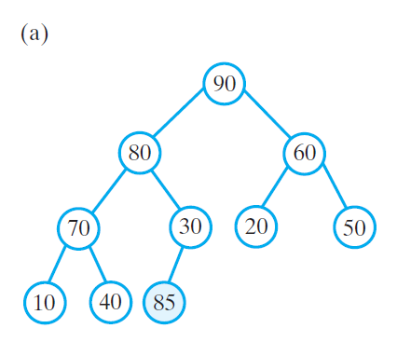
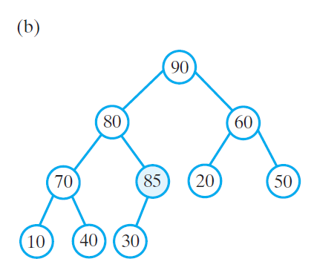
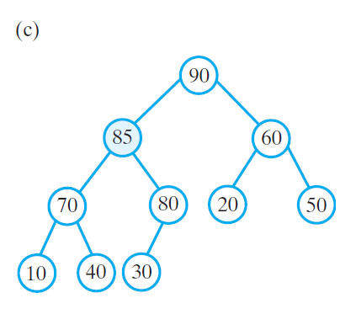
Adding an Entry
To add an entry
Place entry as next leaf in the tree (no more a heap)
Make value float up to its correct location
Adding 85
What is the tree that results from adding 100?

Slide 10
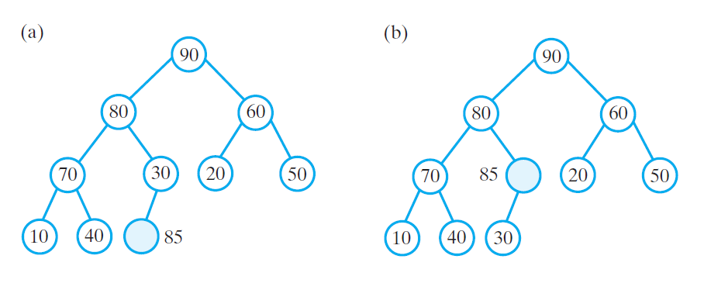
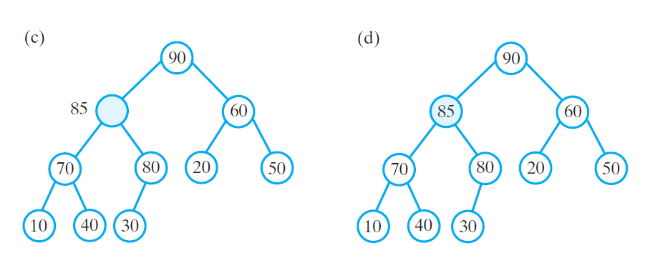
Adding an Entry
How to avoid swaps

Slide 11
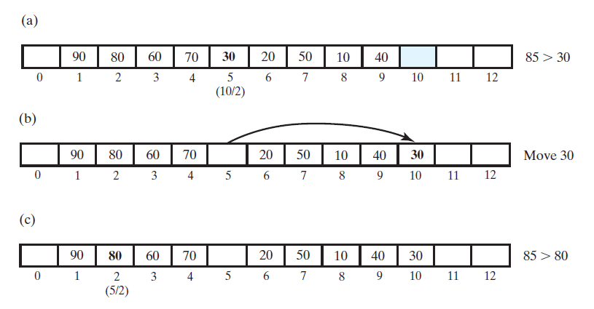
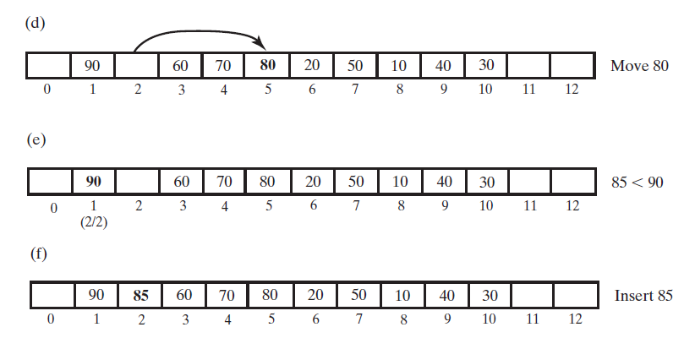
Adding an Entry
Operations from the view point of the array
Index of first empty location : 10
Parent at index 5: 85 > 30, move 30 to index 10
Parent is at index 2: 85> 80: move 80 to index 5
Continue in same fashion

Slide 12
Adding an Entry
To add an entry
public void add (T newEntry){
lastIndex++;
ensureCapacity ();
int newIndex = lastIndex;
int parentIndex = newIndex / 2;
while ((parentIndex > 0) &&
newEntry.compareTo (heap [parentIndex]) > 0) {
heap [newIndex] = heap [parentIndex];
newIndex = parentIndex;
parentIndex = newIndex / 2;
} // end while
heap [newIndex] = newEntry;
} // end add
Complexity:
In worst case method follows a path from leaf to node
The operation is O(logn)

Slide 13
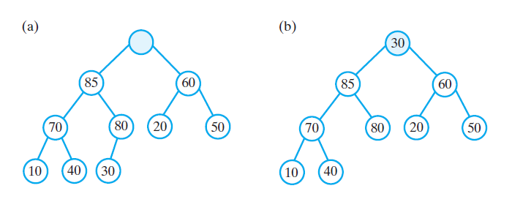
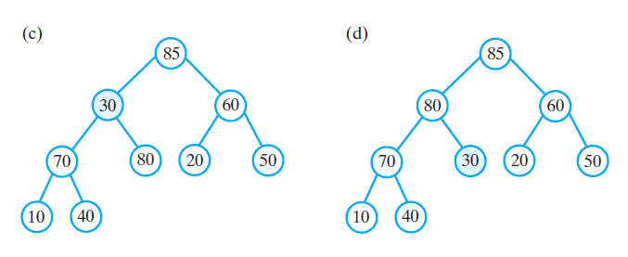
Removing an Entry
To remove root
Remove the last leaf
Copy its contents to root
Let value sink down to correct location

Slide 14
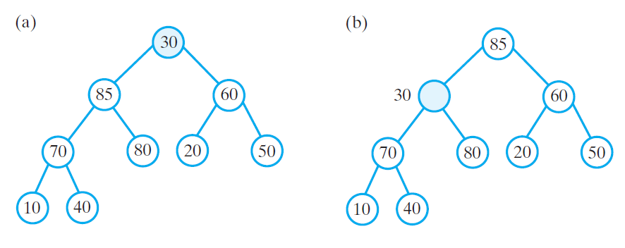
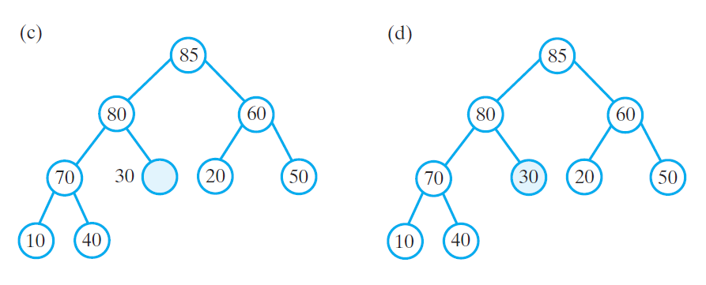
Removing an Entry
Semiheap:
all objects except root are ordered as they should in a heap
How to transform to a heap without swapping?

Slide 15
Removing an Entry
removeMax() method
public T removeMax () {
T root = null;
if (!isEmpty ()) {
root = heap [1]; // return value
heap [1] = heap [lastIndex]; // form a semiheap
lastIndex--; // decrease size
reheap(1); // transform to a heap
} // end if
return root;
} // end removeMax

Slide 16
Removing an Entry
reheap method
private void reheap (int rootIndex) {
boolean done = false;
T orphan = heap [rootIndex];
int leftChildIndex = 2 * rootIndex;
while (!done && (leftChildIndex <= lastIndex)) {
int largerChildIndex = leftChildIndex; // assume larger
int rightChildIndex = leftChildIndex + 1;
if ((rightChildIndex <= lastIndex) &&
heap [rightChildIndex].compareTo (heap [largerChildIndex]) > 0) {
largerChildIndex = rightChildIndex;
} // end if
if (orphan.compareTo (heap [largerChildIndex]) < 0) {
heap [rootIndex] = heap [largerChildIndex];
rootIndex = largerChildIndex;
leftChildIndex = 2 * rootIndex;
}
else
done = true;
} // end while
heap [rootIndex] = orphan;
} // end reheap

Slide 17
Removing an Entry
Complexity:
reheap(): in worst case follows a path from root to leaf, O(logn)
removeMax(): O(1) + O(logn) = O(logn)

Slide 18
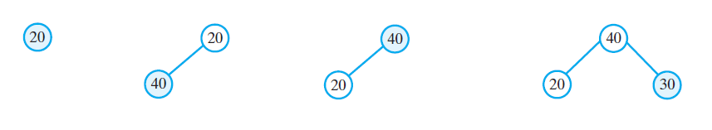
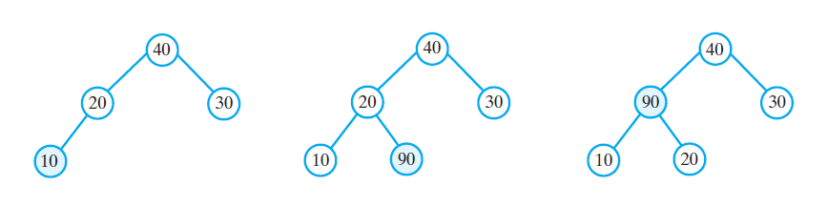
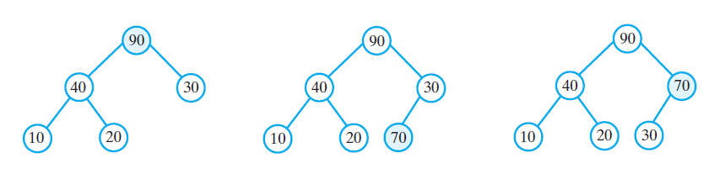
Creating a Heap
We can create a heap by using add method to add each object
add is O(logn) and we are adding n elements so cost is O(nlogn)
Example: 20,40,30,10,90,70

Slide 19
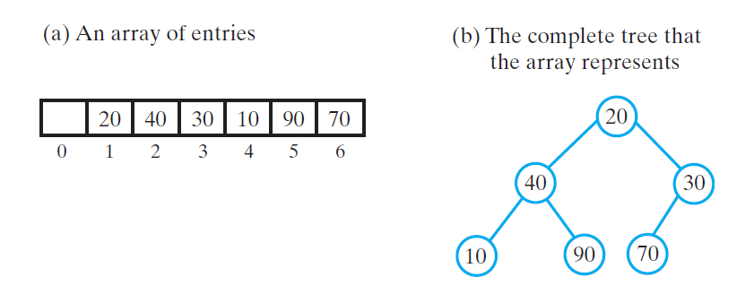
Creating a Heap
We can create a heap by using reheap method
Example: 20,40,30,10,90,70
Look for semiheaps that we should transform into heaps by starting from end of array
tree at 70, 90 and 10 already a heap
Continue moving backward… (next slide)
1
2
3
4
5
6

Slide 20
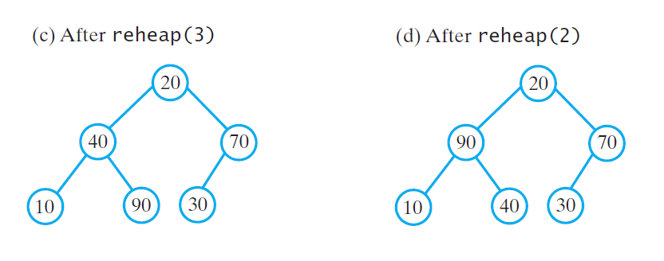
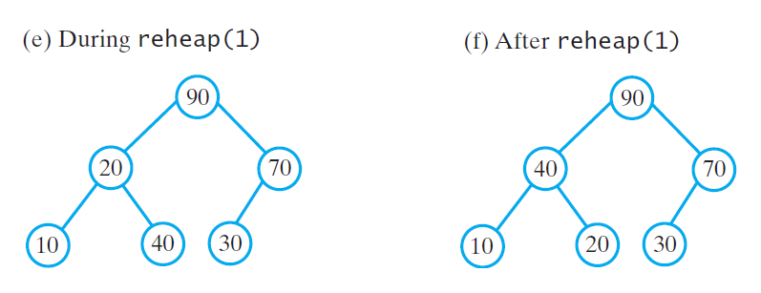
Creating a Heap
Reheap for tree rooted at 70
Reheap for tree rooted at 40
Reheap for tree rooted at 20
1
1
2
3
2
3
4
5
6
4
5
6
1
1
2
3
2
3
4
5
6
4
5
6

Slide 21
Creating a Heap
What is the cost of creating the heap using reheap() method?
reheap is O(h_{i}) where i is the height of subtree rooted at i
In the worst case heap is full tree of height h
What is the height of tree rooted at a node at level l? h – l + 1
Level l contains 2^{l-l} nodes
The heights of all subtrees at level l: (h – l + 1)x2^{l-1}
Nodes at last level h are ignored
Complexity = O(h + (h-1)x2 + (h-2)x4 + …. + 2x2^{h-2})

Slide 22
Creating a Heap
The operation is O(n)

Slide 24
Creating a Heap
Constructor based on previous method
public MaxHeap(T[] entries){
// the cast is safe because the new array contains null entries
@SuppressWarnings("unchecked")
T[] tempHeap = (T[]) new Comparable[entries.length + 1];
heap = tempHeap;
lastIndex = entries.length;
// copy given array to data field
for (int index = 0; index < entries.length; index++)
heap[index + 1] = entries[index];
// create heap
for (int rootIndex = lastIndex/2; rootIndex > 0; rootIndex--)
reheap(rootIndex);
} // end constructor

Slide 25
Heap Sort
If we place array items into a max heap and then remove them one at a time, we will get the items in descending order
What is the time complexity of this sorting approach?
What is the disadvantage of this approach?

Slide 26
Heap Sort
If we place array items into a max heap and then remove them one at a time, we will get the items in descending order
What is the time complexity of this sorting approach?
O(nlogn)
What is the disadvantage of this approach?
O(n) extra memory is required to place removed entries
We can mimic the operation of max heap directly on the array to make it more efficient: heap sort algorithm

Slide 27
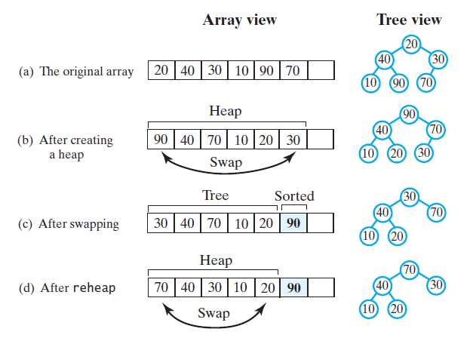
Heap Sort
Create an intial heap by repeated calls to reheap
Largest element is at beginning so move it to end
Call reheap

Slide 28
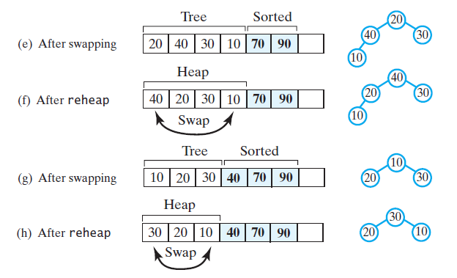
Heap Sort

Slide 29
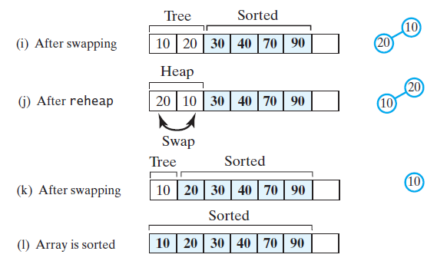
Heap Sort

Slide 30
Heap Sort
private static <T extends Comparable<? super T>>
void reheap(T[] heap, int rootIndex, int lastIndex){
boolean done = false;
T orphan = heap[rootIndex];
int leftChildIndex = 2 * rootIndex + 1;
while (!done && (leftChildIndex <= lastIndex)){
int largerChildIndex = leftChildIndex;
int rightChildIndex = leftChildIndex + 1;
if ( (rightChildIndex <= lastIndex) &&
heap[rightChildIndex].compareTo(heap[largerChildIndex]) > 0){
largerChildIndex = rightChildIndex;
} // end if
if (orphan.compareTo(heap[largerChildIndex]) < 0){
heap[rootIndex] = heap[largerChildIndex];
rootIndex = largerChildIndex;
leftChildIndex = 2 * rootIndex + 1;
}
else
done = true;
} // end while
heap[rootIndex] = orphan;
} // end reheap

Slide 31
Heap Sort
public static <T extends Comparable<? super T>>
void heapSort(T[] array, int n){
// create first heap
for (int rootIndex = n / 2 - 1; rootIndex >= 0; rootIndex--)
reheap(array, rootIndex, n - 1);
swap(array, 0, n - 1);
for (int lastIndex = n - 2; lastIndex > 0; lastIndex--)
{
reheap(array, 0, lastIndex);
swap(array, 0, lastIndex);
} // end for
} // end heapSort
Complexity:
O(n) for initial construction of heap
O(nlogn) for the remaining steps
Total: O(nlogn)

